Slide 1
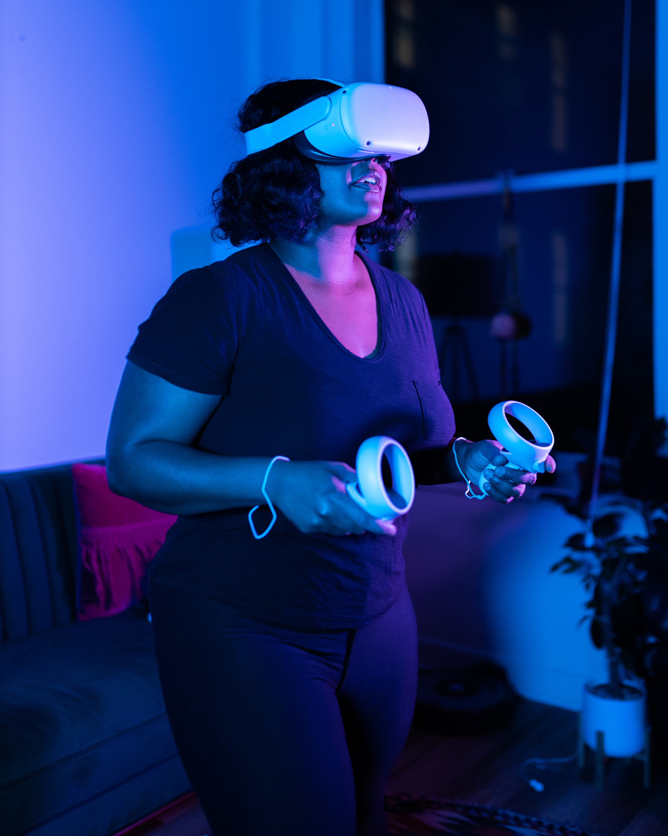
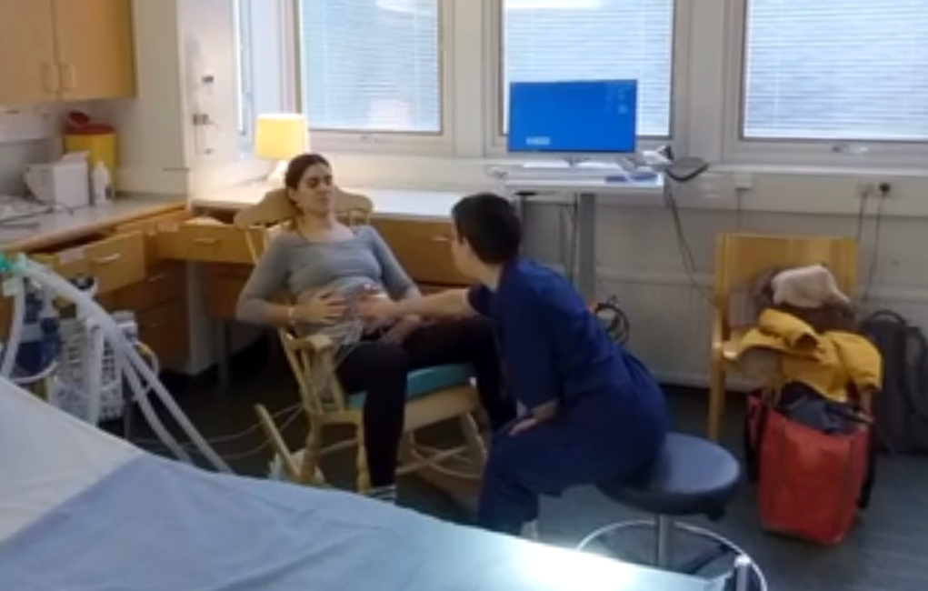
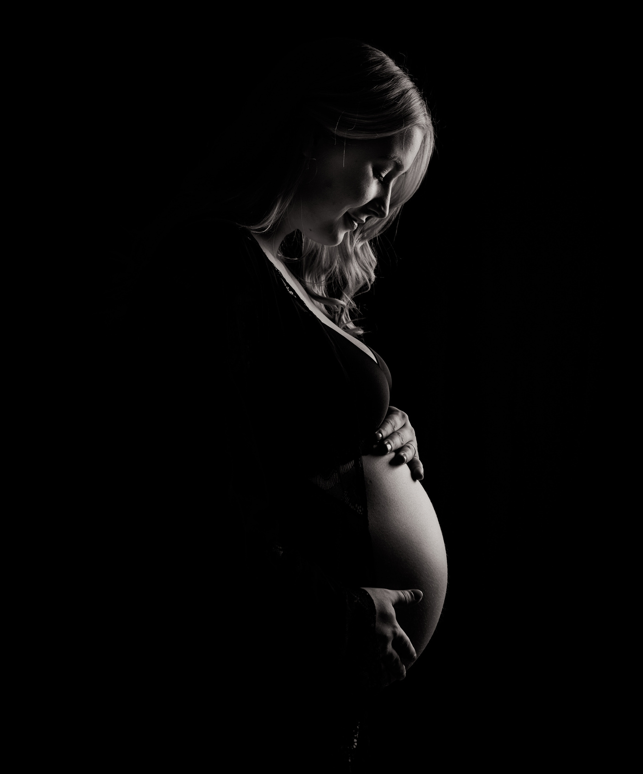
VR
BIRTH
Redefining
Childbirth Preparation
Through Virtual Reality
Marjaana Siivola
A!
Aalto University
01

Slide 2

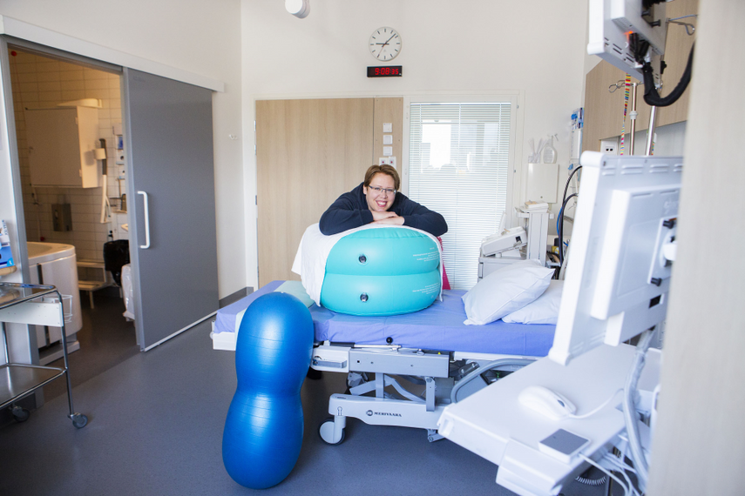
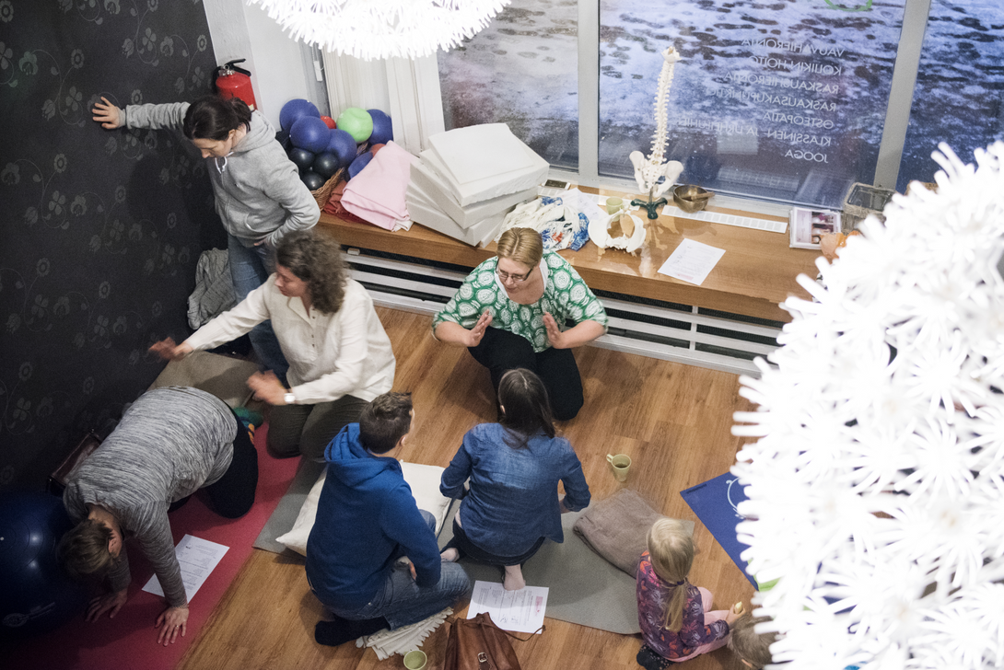
Introduction
MARJAANA SIIVOLA
BIRTH
VR
ENGINEER
HEALTHCARE & CHILDBIRTH
EDUCATION & TECHNOLOGY
Teacher, childbirth educator, eLearning Manager for Healthcare company with
50 000 employees in 7 countries.
Human-Centric design engineer
Doctor of Science (technology)
Childbirth Educator
Career in Healthcare Sector
Adult continuing education in healthcare and with familes

Slide 3
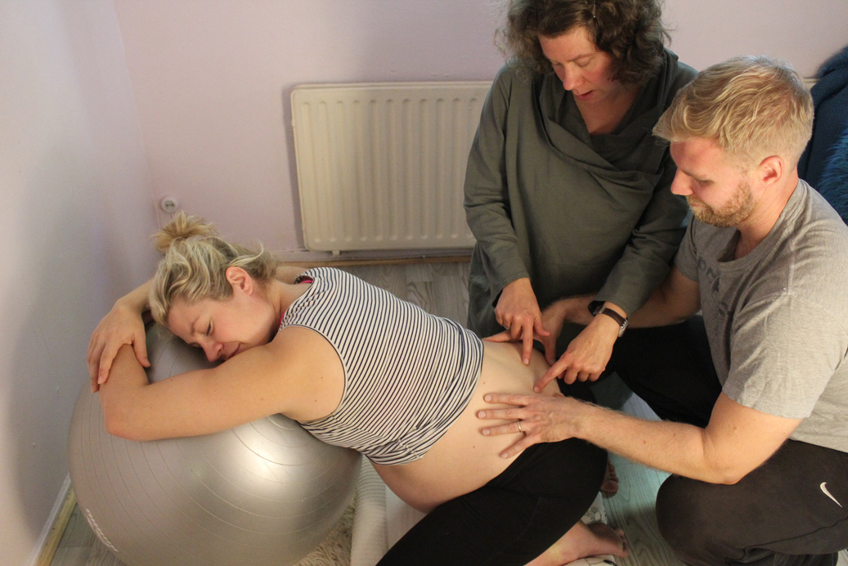
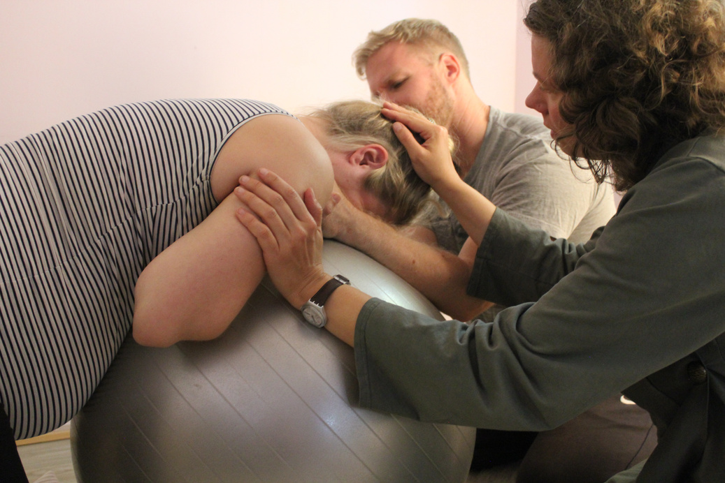
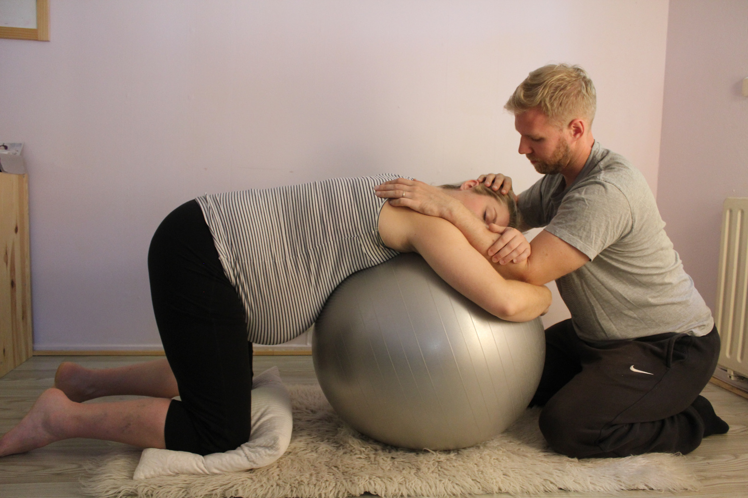

THE PROBLEM
PARENTS ARE UNPREPARED FOR BIRTH
BIRTH
VR
CURRENT SITUATION
CONSEQUENCES
CURRENT GAPS
50%
INCREASED
USER NEEDS ARE NOT MET
of parents do not participate in childbirth education
Stress
Fear of childbirth
Complications
More flexibility
Better accessibility
More realistic information and knowledge to be applied in their own birth
ONLY 33%
DECREASED
of parents who participated, reached the main learning goals
Mental health
Coping
Ability to make informed decisions

Slide 4
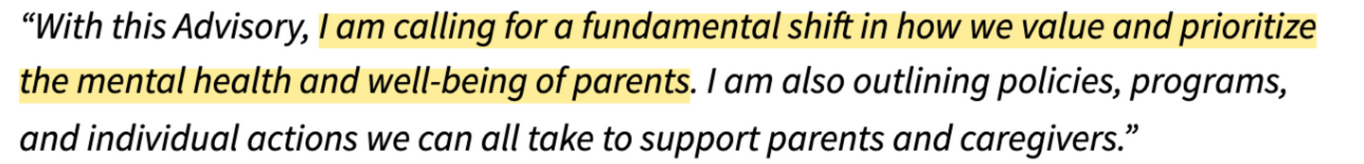
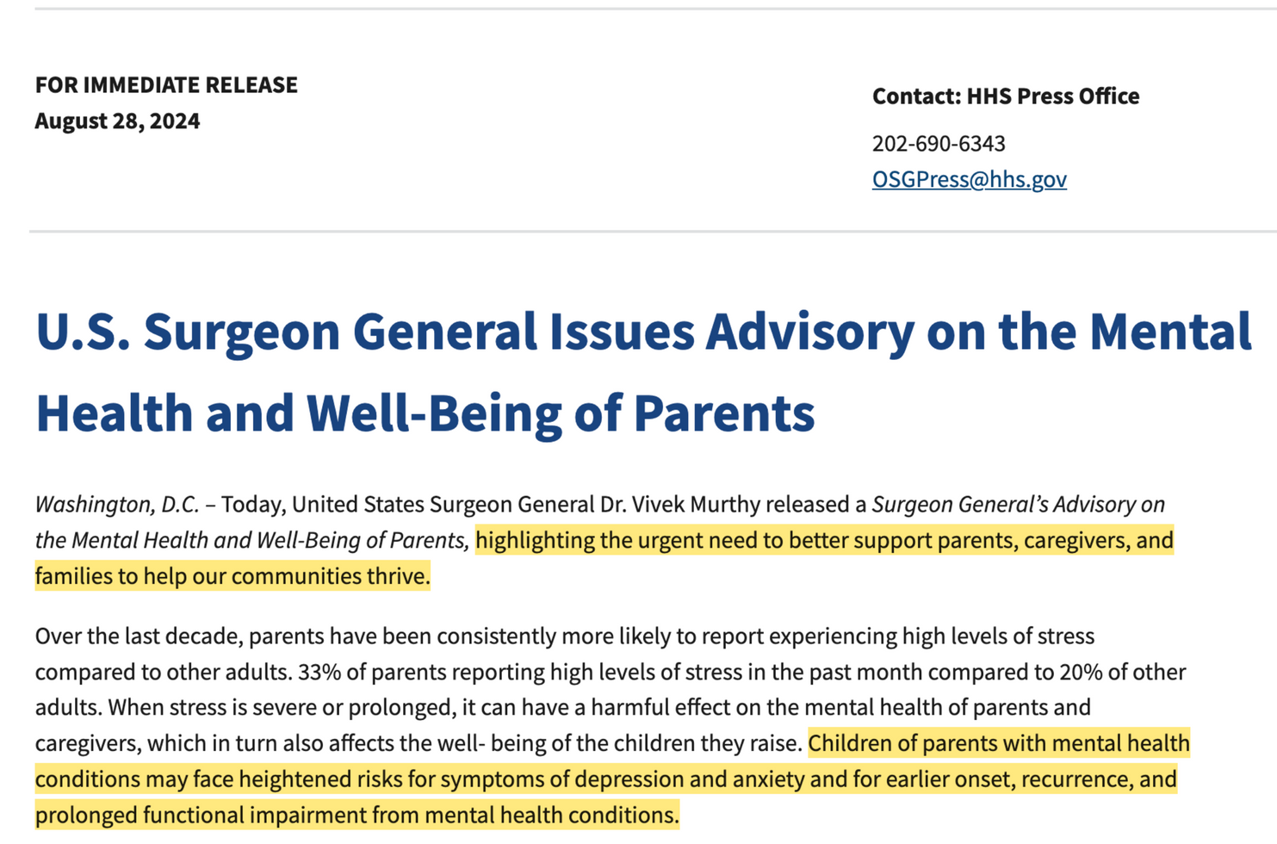
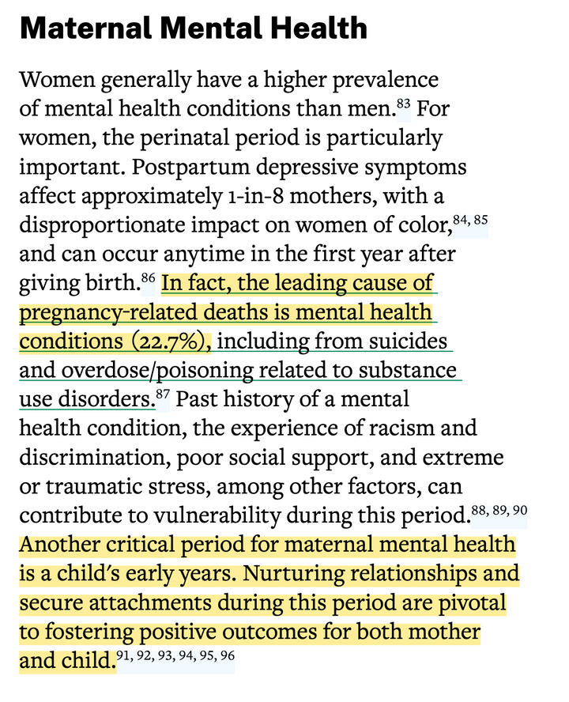
THE PROBLEM
PARENTS’ MENTAL HEALTH CRISIS
BIRTH
VR
https://www.hhs.gov/sites/default/files/parents-under-pressure.pdf
https://www.hhs.gov/about/news/2024/08/28/us-surgeon-general-issues-advisory-mental-health-well-being-parents.html

Slide 5
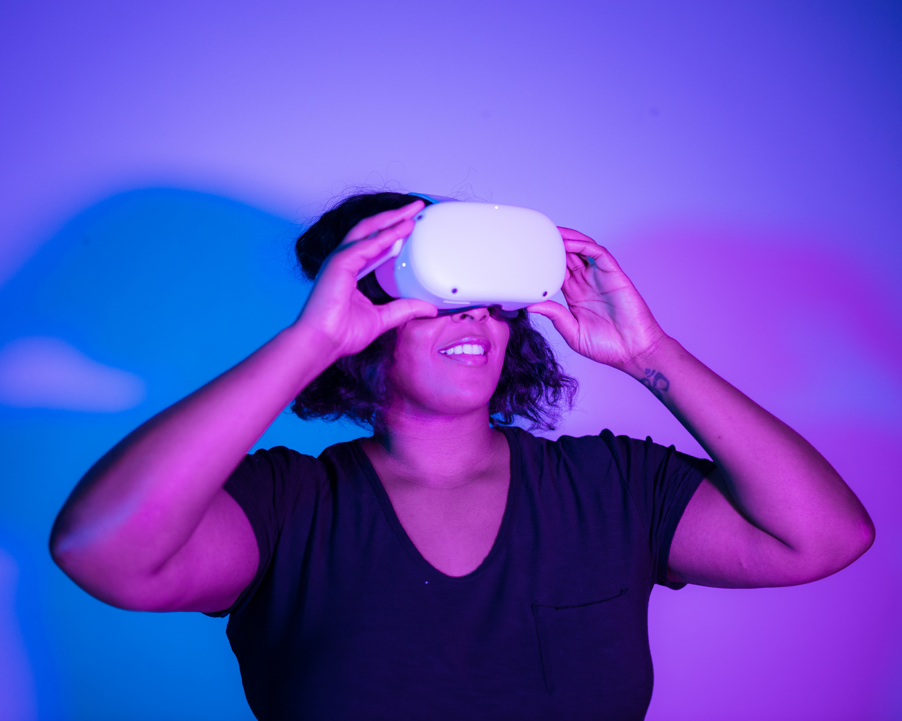
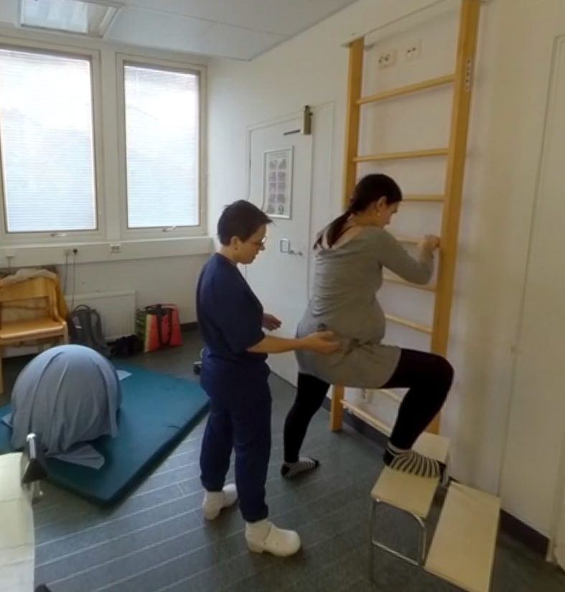
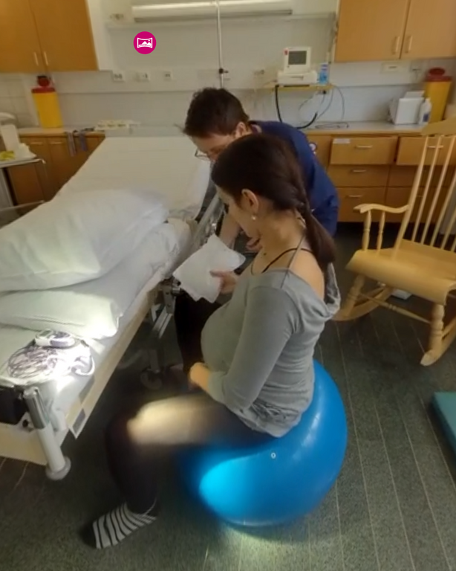
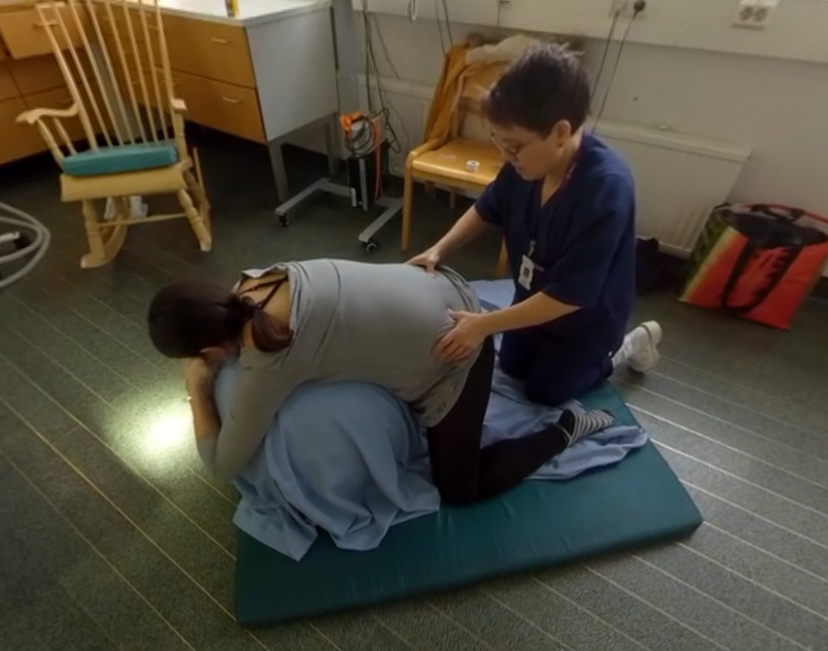
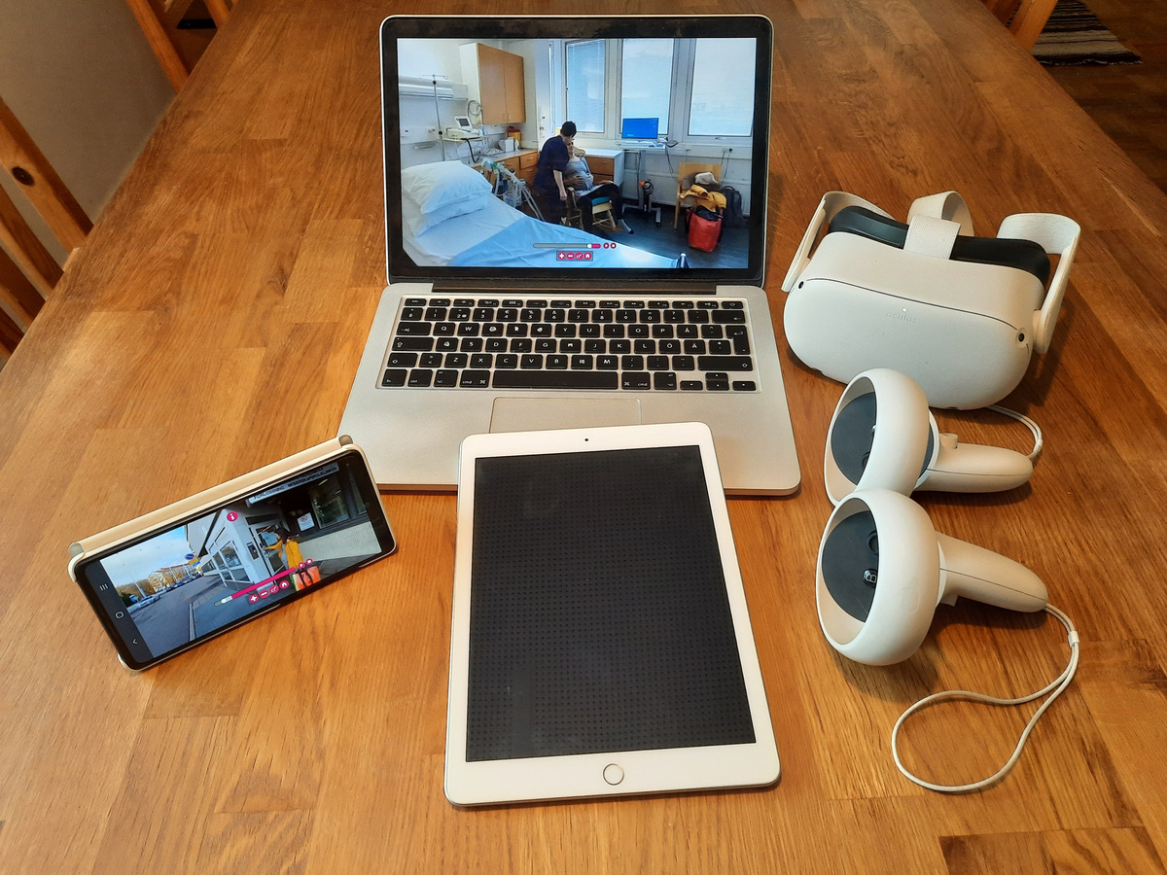
THE SOLUTION
EXPERIENCE WHAT IT IS TO GIVE BIRTH
BIRTH
VR
BIRTHVR
THE UNIQUE APPROACH TO PREPARE FOR BIRTH IN VIRTUAL REALITY
USER REQUIREMENTS:
Flexible - online, available 24/7
Realistic - easy to apply knowledge
Tour of the hospital birth ward
Accessible - can be used with different end-user devices

Slide 6
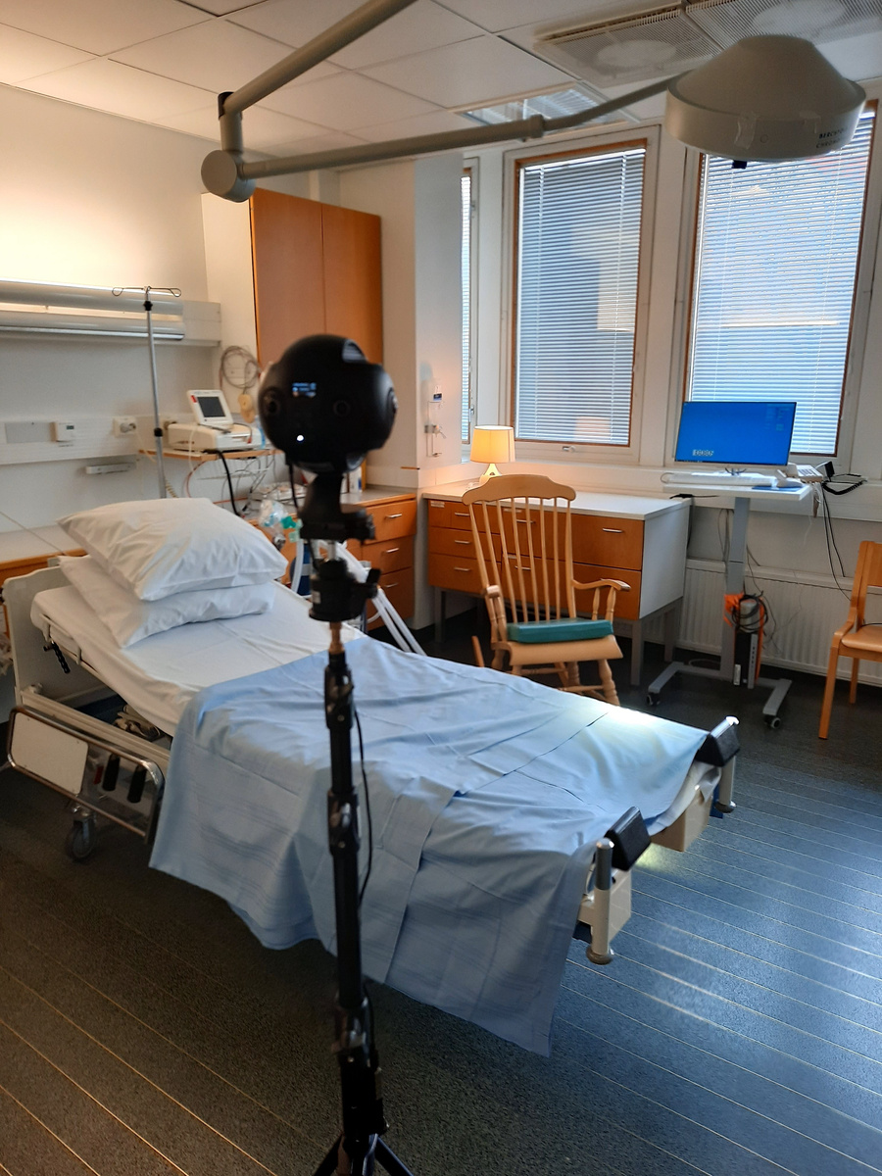
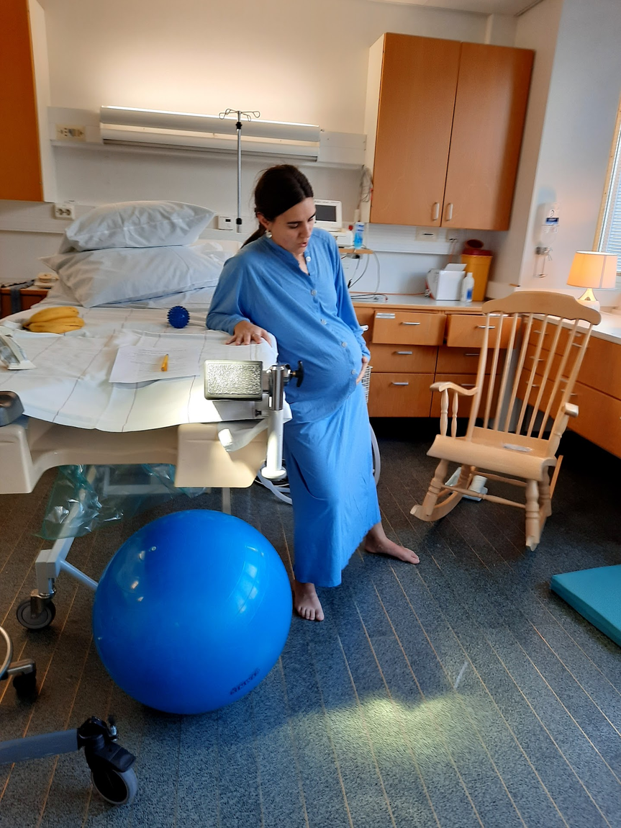
Techonology
DEVELOPMENT
BIRTH
VR
Human-centric Design
DEFINED Target users and their needs (pregnant, their spouses, hospital, prenatal care, students)
Looked who the participants and stakeholders are and their level of knowledge
Designed the content into a script
Planned how the content was laid out: Intro + Master node + Content films
Accessibility - usable in different devices
Usability - ituitive, no guidance needed
FILMING
Cast: A pregnant person and a midwife
Capturing audio separately with a hidden mic
Capturing with max. resolution of Pano2VR: 4K with Insta360 Pro

Slide 7
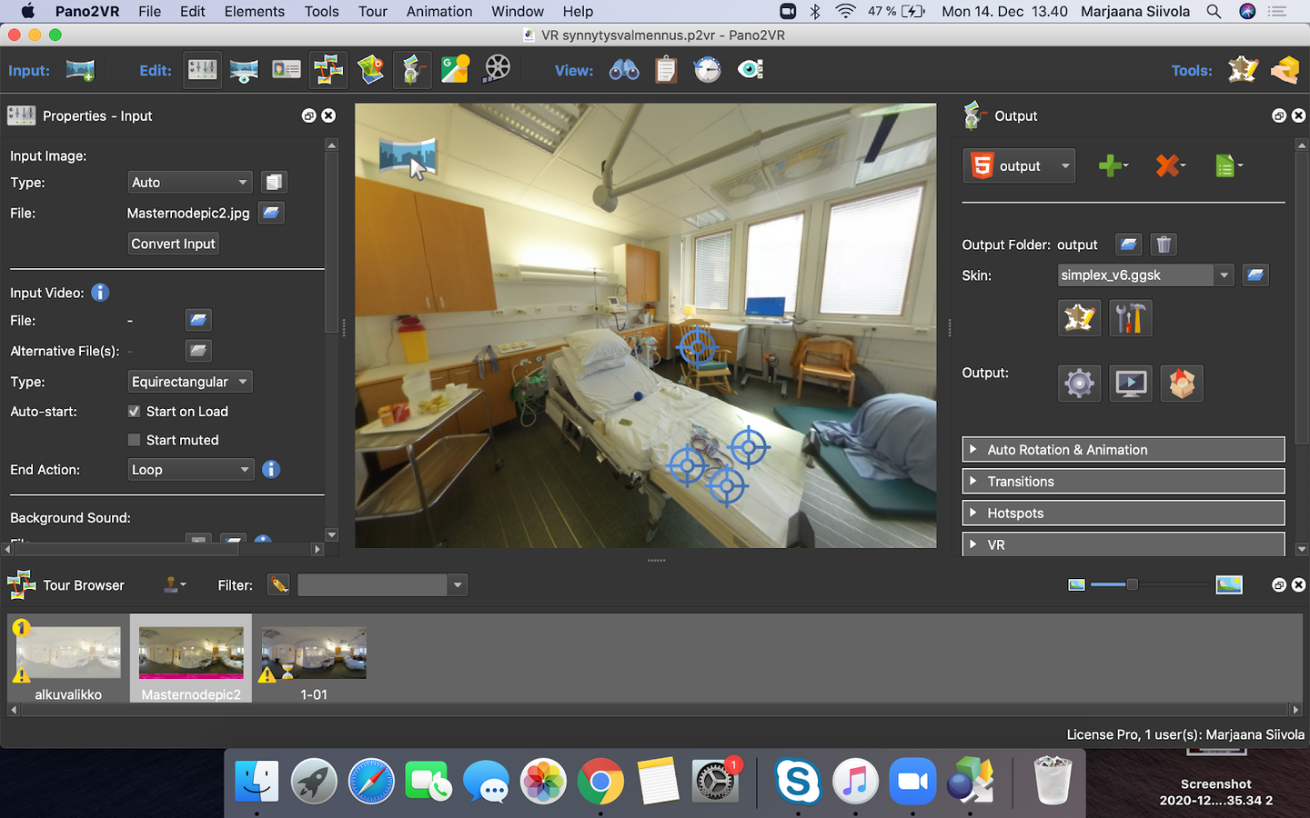
Techonology
DEVELOPMENT
BIRTH
VR
Editing
Stitching 6 cameras to equirectangular (mono) videos with Premier Pro
Matching audiofiles with video
Creating Master sequence with all the clips for script
Recording voice over narrative (in APod) for making shorted films
Editing clips based on script
COMPOSITION & ANNOTATION
Composing all the material to scenes and hot spots in Pano2VR
Exporting project and embedding it to the web site

Slide 8

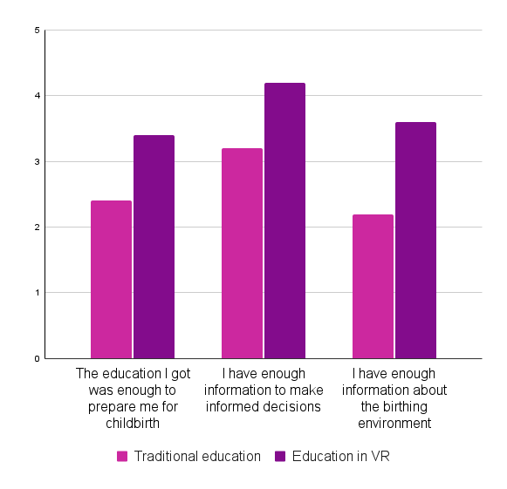
User studies
USER VALIDATION
BIRTH
VR
USER STUDIES VALIDATED THAT BIRTHVR MEETS USERS’ UNMET NEEDS
It feels very concrete.
The training came to live with VR
WE CONDUCTED USER STUDIES WITH
Parents who had given birth
Expecting parents
Midwives
I learned how to use the birthing ball after seeing it
RESULTS
THE learning outcomes improved. Larger studies needed to see how much
Users felt they visited the birth room (4.2/5)
Usability score
A+ (PSUS 87/100) for VR
B (PSUS 76/100) for other devices
360° videos bring added value (4,6/5)
VR brings less added value (3,6/5)
This provides a possibility to "be there”
This can add a
sense of security

Slide 9
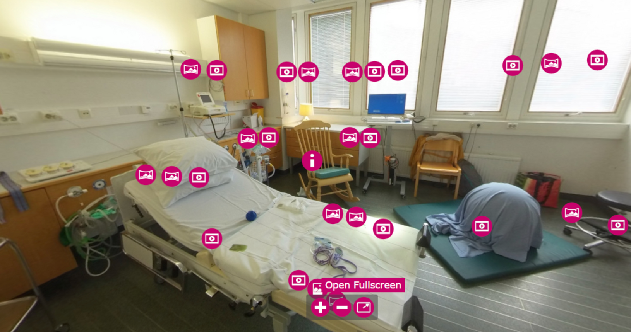
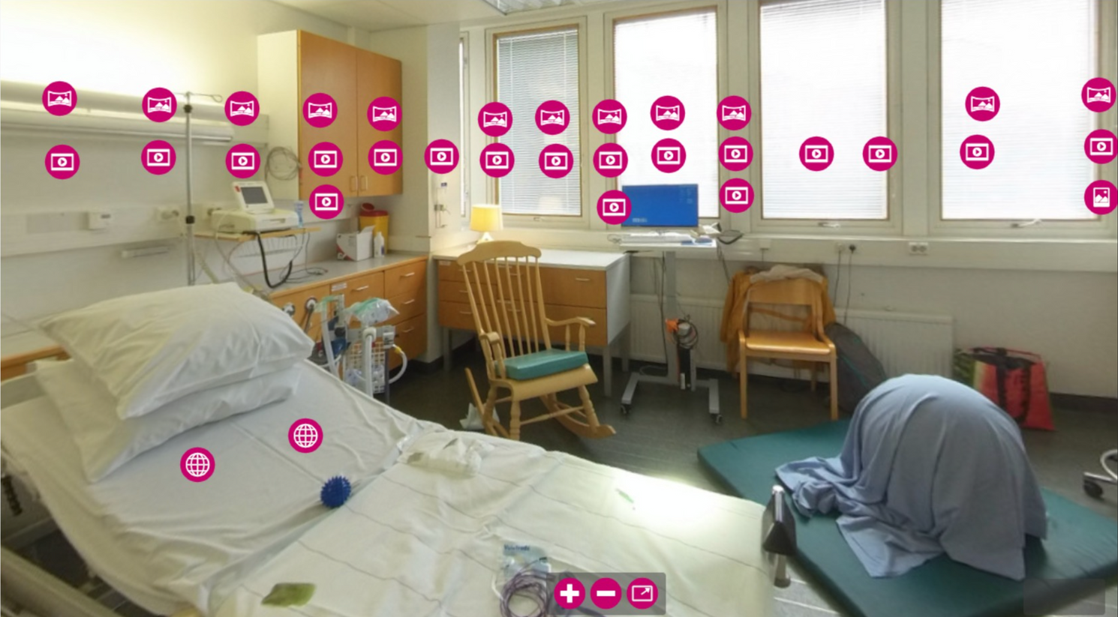
User Studies
USABILITY RESULTS
BIRTH
VR
CONTENT PLACEMENT MATTERS
In the first version, the videos were placed where the action happened.
In the second version, the content was lined up according to the progression of birth.

Slide 10
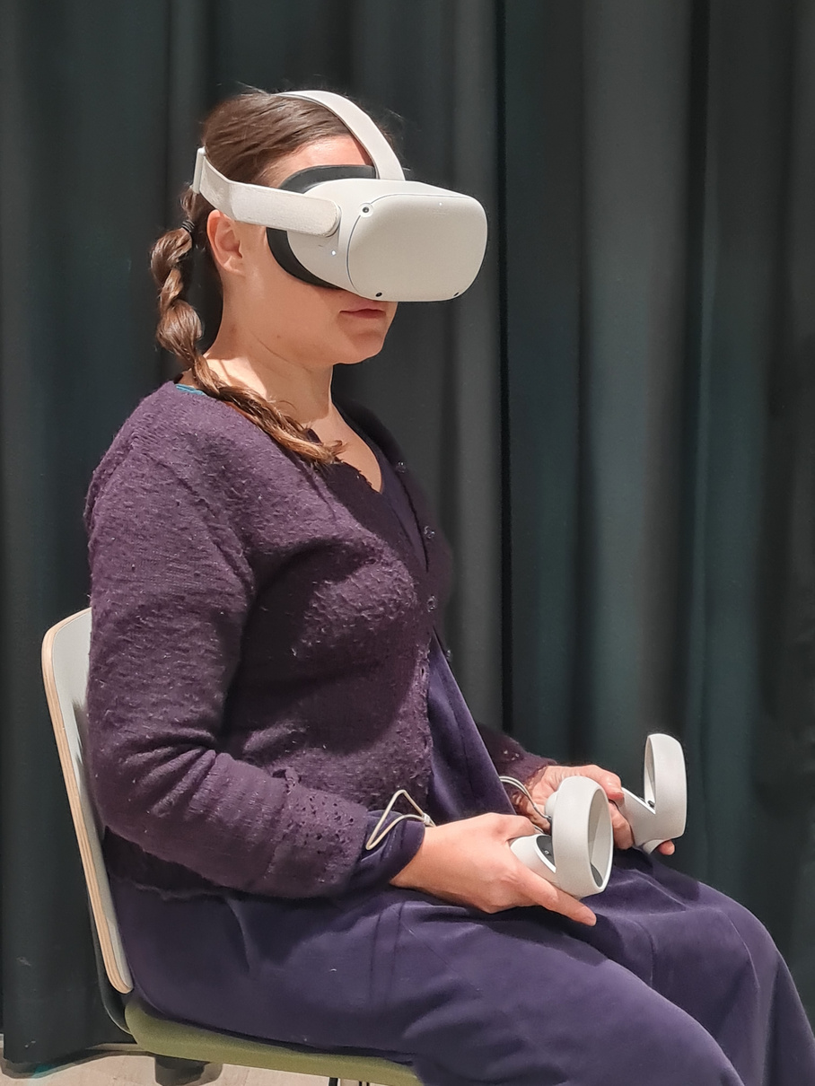
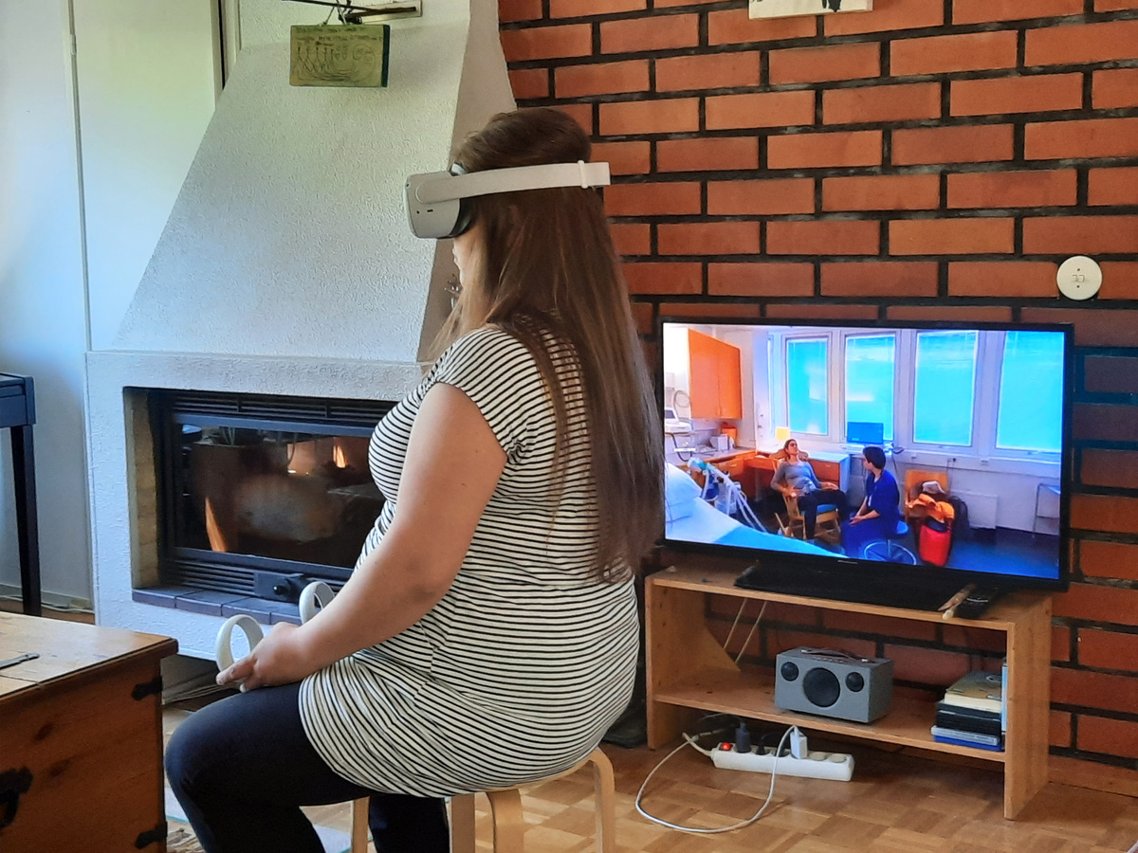
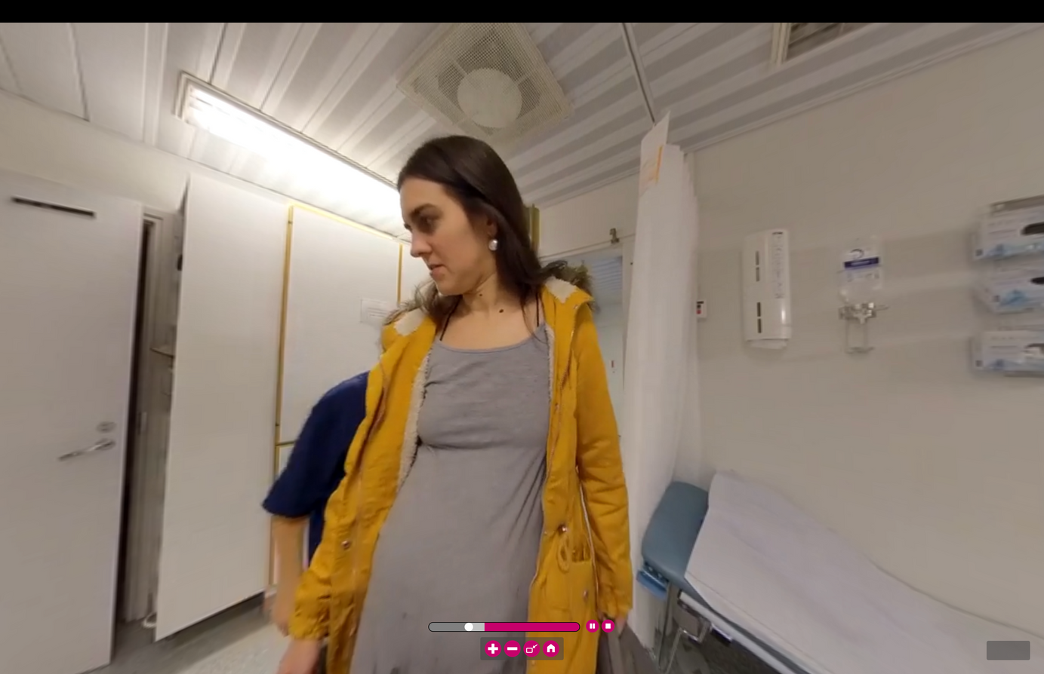
User Studies
USABILITY RESULTS
BIRTH
VR
BEING SEATED AND FILMING ISSUES
When the actor came too close to the camera, the users moved away in the natural world.
The VR World was slightly bigger and floor level a bit different than the natural world causing discomfort.
If the program does not require moving, have the person sitting on a turning chair without rolling wheels.

Slide 11
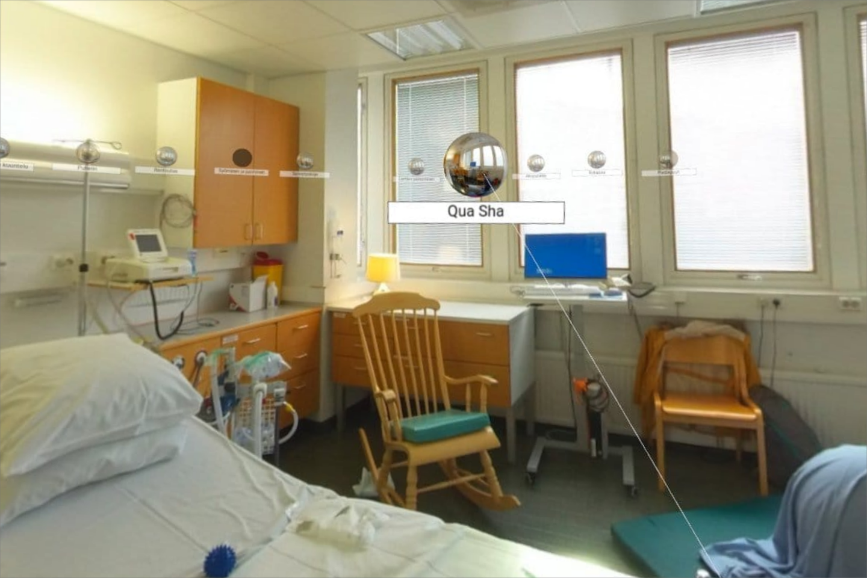

User Study
USABILITY RESULTS
BIRTH
VR
MORE RESEARCH NEEDED ON THE AMOUNT OF CONTENT PRESENTED FOR THE USER
VR had only 360 videos visible (technical issues with Pano2VR).
A computer, tablet and smartphone had audio clips, photos, and links.
Additional content got negative feedback as well “too much”.

Slide 12
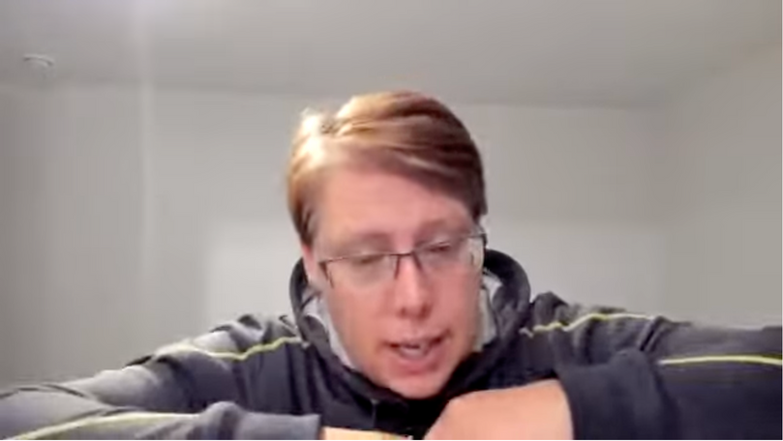
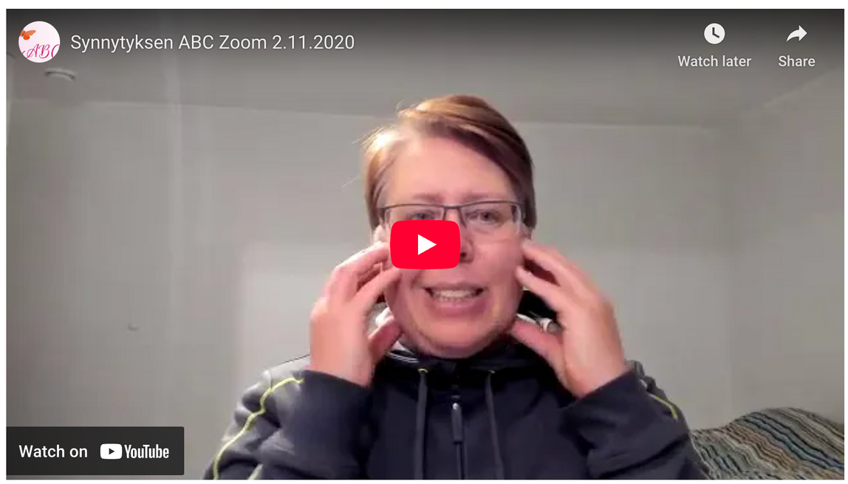
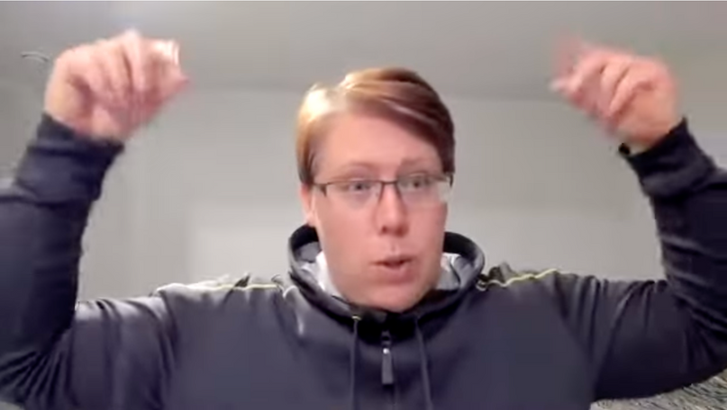
Interaction and connection
FLIPPED LEARNING
BIRTH
VR
BIRTHABC
FURTHER USER REQUIREMENTS:
Contact with professional
Peer-support
Flexibility
ONLINE FLIPPED LEARNING
Online course for self-learning
Regular online meetings for Q&A and discussion
Main takeaway
Have a way to provide connection to the user (professional/teacher and peers)!

Slide 13

SUMMARY
BIRTH
VR
RESULTS
Virtual reality offers a concrete and realistic experiential learning environment, helping parents understand what to expect during childbirth, how to communicate with midwives, and what to anticipate in the birthing room.
Flipped learning introduces much-needed flexibility, provides interaction with professionals, and fosters peer support.
Research produced
Usability considerations for VR educational program
Instructional model for online flipped learning for informal adult continuing education
Next
Multiuser VR childbirth education for contact with professinal and peer support incorporated into the VR program
BirthVR can improve learning outcomes
Studies confirmed BirthVR fulfills current needs
Professionals
agree BirthVR enhances current education needs
Lessons learned can be used in continuing and patient education

Slide 14

PROGRAM
BIRTH VR
BIRTH
VR
DOULES.FI/VR

Slide 15
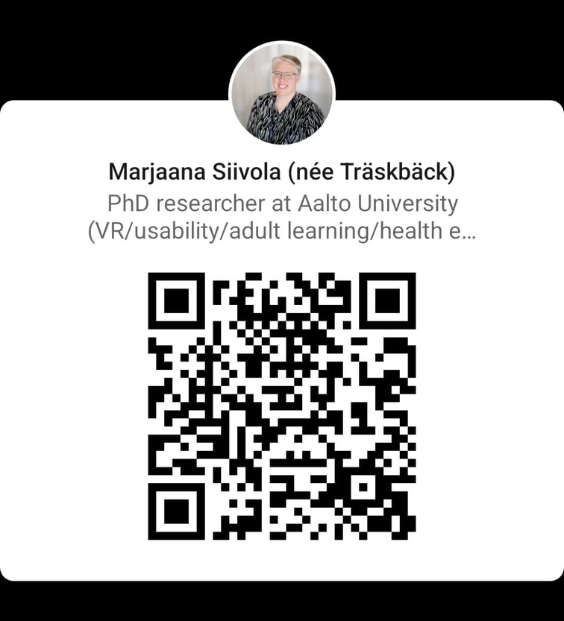
THANK YOU
BIRTH
VR
CONTACT MARJAANA SIIVOLA
ACADEMIC PUBLICATIONS
Aalto University - PhD
Mehiläinen - elearning manager
Doules - CEO, childbearing services
email: marjaana@doules.fi
LinkedIn: msiivola
Family and Childbirth Education Supporting the Well-being of Families: Could Virtual Reality Help? Perhe- ja synnytysvalmennus perheiden hyvinvoinnin tukijana: Voisiko virtuaalitodellisuudesta olla apua? Siivola, Marjaana; Leinonen, Teemu. 2022. Yhteiskuntapolitiikka 3/2022. https://urn.fi/URN:NBN:fi-fe2022060844642
Flipping Childbirth Education. Siivola, Marjaana; Malmi, Lauri. 2024. Journal of Perinatal Education 33(3): 127-147, July 2024, https://doi.org/10.1891/JPE-2023-0014
Virtual Reality Childbirth Education with 360° Content. Siivola, Marjaana; Tiainen, Eero; Ekholm, Eeva; Leinonen, Teemu; Malmi, Lauri. 2023. Journal of Perinatal Education. 2023 Jan 1; 32(1): 35–47. doi: 10.1891/JPE-2021-0021 https://doi.org/10.1891/JPE-2021-0021
Effectiveness of Virtual Reality Childbirth Education. Siivola, Marjaana; Leinonen, Teemu; Malmi, Lauri. 2024. Computers and Education: X Reality 2024, volume 4. https://doi.org/10.1016/j.cexr.2024.100058
Midwives´account of Virtual Reality Childbirth Education. Siivola, Marjaana; Malmi, Lauri. 2024. Finnish Journal of eHealth and eWellfare Vol. 16 No. 3 (2024) https://doi.org/10.23996/fjhw.143462
The Impact of Online Flipped Childbirth Education with Virtual Reality. Marjaana Siivola. Aalto University publication series, Doctoral Theses 65/2025

Slide 16

QUESTIONS?
BIRTH
VR
DOULES.FI/VR
LinkedIn
Video link

